Slide 1
SQL DATA AGGREGATION
James Larkin – Data Analytics Instructor

Slide 2
DATA AGGREGATION IN SQL
OPENING

Slide 3
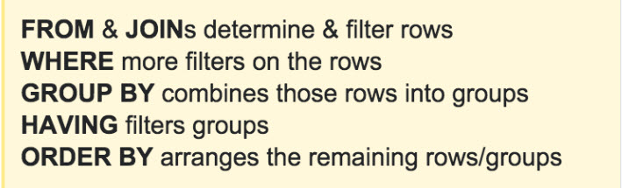
THE SELECT QUERY: SYNTAX REVIEW
SELECT picks the columns.
FROM points to the table.
WHERE puts filters on rows.
GROUP BY aggregates across values of a variable.
HAVING filters aggregated values after they have been grouped.
ORDER BY sorts the results.
LIMIT limits result to the first n rows.

Slide 4
LIGHTNING ROUND REVIEW
CREATING MULTIPLE JOINS REVIEW
Name the JOIN selected for highlighting missing rows.
How do you indicate which table is primary versus secondary when constructing a JOIN?
Describe a business use case for implementing a FULL JOIN.
What is the primary difference between connecting keys with USING and connecting keys with the ON command?

Slide 5
LEARNING OBJECTIVES
DATA AGGREGATION IN SQL
Explain the differences between NULL and zero.
Explore the issues of math equations and NULLs.
Use SQL NULL to create Boolean functions and handle zeros.
Use CASE statements to add “IF THEN ELSE” logic to SQL.

Slide 6
DATA AGGREGATION IN SQL
INTRODUCTION: WORKING WITH NULLs

Slide 7
WORKING WITH NULLs
A NULL represents missing data, but a NULL is different than a zero or a blank.
A blank cell could have been left blank on purpose.
In some cases, a blank represents data.
When NULLs exist in a data set that was the result of joined tables, the presence of a NULL often has meaningful implications.
What is your company’s best practice or policy for handling NULLs? If your company doesn’t have one, what do you think you should do?

Slide 8
NULLS AND MATH
It can be tricky working with NULLs and zeros if the analysis requires addition/subtraction or division.
No dividing by zero.
Can’t add or subtract a NULL.
Various SQL tools can solve either situation. For example:
Using a CASE statement, you can change zeros to NULLs.
NULLIF can substitute a NULL for a zero value, allowing division equations to execute without an error condition.

Slide 9
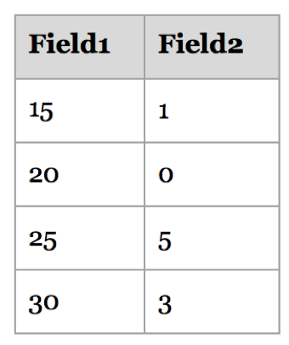
EXAMPLE: NULLIF
NULLIF(field,testing_value)
Returns NULL if expressions (field1 & testing_value) are equal.
Otherwise returns the first expression.
NULLIF can test for zero values.
Example: Using the sample table on the right, divide Field 1 by Field 2. You must ensure there are no zeros in Field 2:
SELECT Field1/NULLIF(Field2,0)
Notes:
Example Answer: SELECT Field1/NULLIF(Field2,0)

Slide 10
WORKING WITH NULLS
COALESCE returns the first of its arguments that is not null.
Example syntax:
SELECT COALESCE(description, short_description, '(none)’)
SELECT COALESCE(field_you_want, value_to_fill_in_if_field_is_null)

Slide 11
DATA AGGREGATION IN SQL
GUIDED PRACTICE: NULLS AND JOINS

Slide 12
NULLS AND JOINS
You can find NULL data using the WHERE clause.
Run:
SELECT p.name, p.color
FROM production.product AS p
WHERE p.color = ‘NULL’;
Do you expect problems with this statement? Why or why not?

Slide 13
NULLS AND JOINS
To find NULL values, we use the SQL function “IS NULL.”
Run:
SELECT p.name, p.color
FROM production.product AS p
WHERE p.color IS NULL;
This will return all of the rows where the color field is NULL.
Notes:
This query returns (248 rows)

Slide 14
NULLS AND JOINS
We can also find non-NULL values by using IS NOT NULL — the opposite of IS NULL.
Run:
SELECT p.name, p.color
FROM production.product AS p
WHERE p.color IS NOT NULL;
Notes:
This query returns (256 rows)

Slide 15
DATA AGGREGATION IN SQL
INTRODUCTION:
CASE STATEMENTS

Slide 16
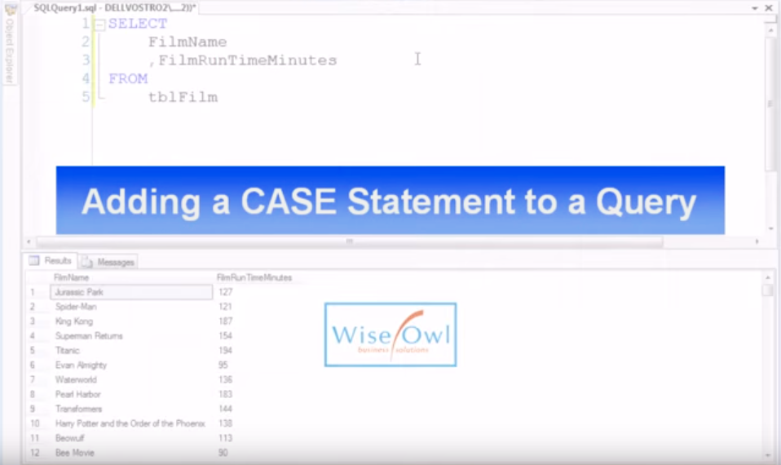
CASE STATEMENTS
Notes:
Video lnk: https://youtu.be/zlgrhj2D63E

Slide 17
CASE STATEMENTS
CASE statements group data into categories or classifications and adds that information into a new column.
In SQL, CASE is part of the columns list in the SELECT statement.
CASE statements also appear in Excel, using the following logic:
IF,
THEN,
ELSE,
and ELSEIF.

Slide 18
CASE STATEMENTS
CASE syntax looks like this:
SELECT columns,
CASE
WHEN condition THEN result
WHEN condition THEN result
ELSE condition
END AS output_name
FROM table;
Notes:
Pro Tip: Note that when you GROUP BY your CASE condition, you don’t include the alias. That is, your group wouldn’t include AS output_name.
DONT FORGET YOUR END!!!

Slide 19
CASE STATEMENTS
Let’s try CASE out:
SELECT DISTINCT p.color,
CASE
WHEN p.color ILIKE 'Red' THEN 1
WHEN p.color ILIKE 'White' THEN 2
WHEN p.color ILIKE 'Blue' THEN 3
ELSE 0
END AS colorint
FROM production.product AS p;
Notes:
Pro Tip: Note that when you GROUP BY your CASE condition, you don’t include the alias. That is, your GROUP BY wouldn’t include AS output_name.

Slide 20
DATA AGGREGATION IN SQL
GUIDED PRACTICE: CASE STATEMENTS

Slide 21
CASE STATEMENTS
Let’s say we want to classify our product list prices as either:
Free ($0!)
Cheap (up to $50)
Affordable ($50 to $300)
Expensive ($300+)
How would we go about this?

Slide 22
CASE STATEMENTS
SELECT p.listprice,
CASE
WHEN p.listprice <= 0 THEN 'free'
WHEN p.listprice <= 50 THEN 'cheap'
WHEN p.listprice <= 300 THEN 'affordable'
WHEN p.listprice > 300 THEN 'expensive'
END AS affordability
FROM production.product AS p
ORDER BY 1;

Slide 23
CASE STATEMENTS
Note that we define each size category. SQL will only return values that meet these conditions.
We can also add an “other” category if we want to include an ELSE ‘other’ before the END AS “affordability” line. This will capture any missing data.
Pro Tip: while the use of indentation is helpful, it’s not necessary in SQL.

Slide 24
CASE STATEMENTS
Next we’ll look at an example of CASE being used within a SELECT statement to generate an aggregate.
Calculate the percentage of items in the product offerings that are mountain bike products.

Slide 25
CASE STATEMENTS
SELECT ROUND(AVG(
CASE
WHEN p.name ILIKE('Mountain%') THEN 1
ELSE 0
END
)::decimal*100,2) AS mtn_percent
FROM production.product AS p;

Slide 26
DATA AGGREGATION IN SQL
INDEPENDENT PRACTICE- HOMEWORK: PUTTING IT ALL TOGETHER

Slide 27

ACTIVITY: PUTTING IT ALL TOGETHER
DIRECTIONS
EXERCISE
Identify the items in the products table that have a weight of NULL.
Create a count of these NULLs.
Convert all weights in the product table that are null to the value 0 using COALESCE

Slide 28
DATA AGGREGATION IN SQL
CONCLUSION

Slide 29
REVIEW: DATA AGGREGATION IN SQL
In this lesson, we:
Explored methods of dealing with NULLs in tables, including: NULLIF, IS NULL, IS NOT NULL, and COALESCE .
Reviewed CASE statements for adding categories and aggregates, using Boolean logic structures.
Practiced evaluating and interpreting the presence of NULLs that occur as a result of joining tables together.

Slide 30
UNIT RECAP
UNIT 2: REVIEW

Slide 31
WHAT HAVE WE LEARNED SO FAR?
In Unit 2 so far, we have learned how to:
Explain and connect to SQL databases.
Define SQL grammar, syntax, and punctuation.
Use SQL’s SELECT statement with WHERE clauses.
Use query commands, including DISTINCT, COUNT, AND, OR, and CAST.
Apply SQL commenting, using -- and /* comment */.
Apply SQL conditional operators =, !=, >, <, IN, NOT IN, and BETWEEN.
Use the SQL Boolean operator OR to include only the desired data.
Filter data with the commands GROUP BY and HAVING.
Use the aggregate functions MIN, MAX, SUM, AVG, and COUNT.
Apply calculations to fields using the order of operations (PEMDAS).
Create relationships between tables, including:
INNER, RIGHT, and LEFT JOINS.
FULL OUTER JOINS.
EXCEPTION JOINS.
Optimize our queries with WHERE, LIMIT, and COALESCE.
Explain the differences between NULL and zero.
Explore issues with math equations and NULLs.
Use SQL NULLs to create Boolean functions and handle zeros.
Use CASE statements to add “IF, THEN, ELSE” logic to SQL.

Slide 32
DATA AGGREGATION IN SQL
RESOURCES
“Strategies for Approaching NULL Values with SQL Server:” https://goo.gl/wALy62
“Handling Null Values,” Microsoft SQL: https://goo.gl/4frfgz
CASE Statement YouTube Video From WiseOwl: https://youtu.be/zlgrhj2D63E
TechOnTheNet.com for SQL Server NULLIF Reference: https://goo.gl/AFeKuV

